Slide 1


AI-Powered Stroke Risk
Forecast

Slide 2
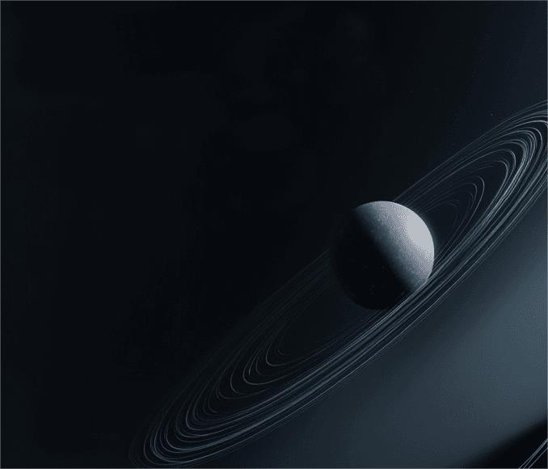
01 02 03 04 05
06
Stroke & Data Landscape
Model Blueprint Validation & Ethics Clinical Deployment Impact & Next Steps Takeaways

Slide 3

01
Stroke & Data Landscape

Slide 4

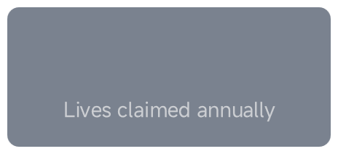
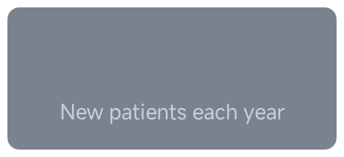
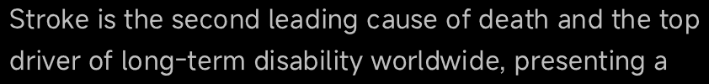
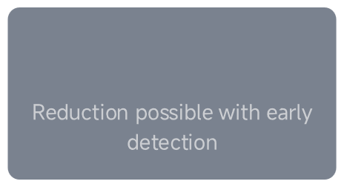
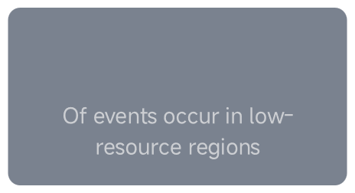
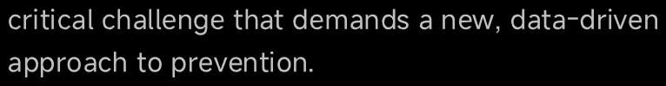
6.5M
30%
12M
80%
The Silent Global Burden of Stroke

Slide 5

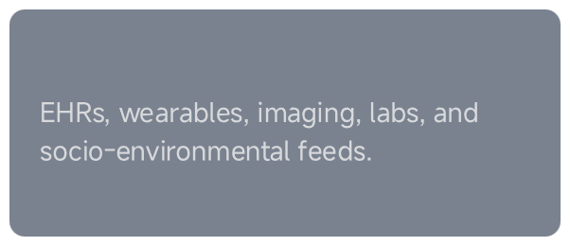
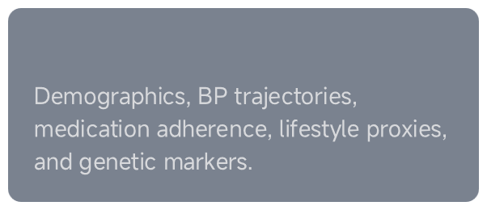
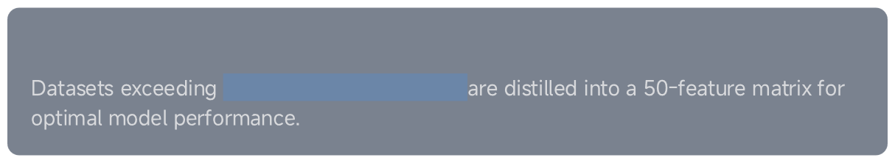
Clinical Data Goldmine Unpacked
Data Sources
Key Predictors
Scale & Granularity
300variables per patient

Slide 6
02
Model Blueprint

Slide 7




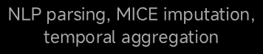

From EHR to Model Matrix: The Data Pipeline
Raw EHR Data
Pro cessi ng
Feature Matrix
granularity with computational tractability

Slide 8
Algorithm Lineup & Performance
Model
Logistic Regression
Cross-Validated AUC
0.78
Key Strengths
Interpretable baseline
Random Forest
0.85
Captures non-linear interactions
XGBoost
0.91
Superior performance on BP-lipid interactions
RNN
0.88
Exploits temporal visit sequences
1.2 million patient records

Slide 9
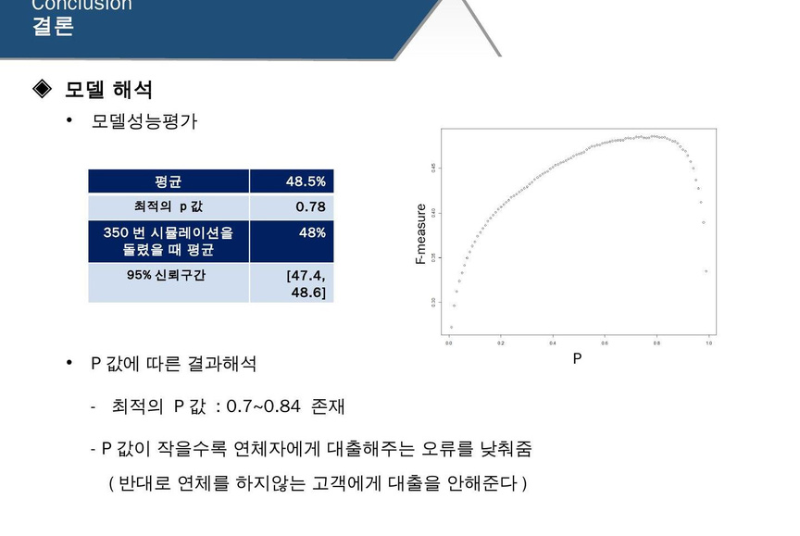
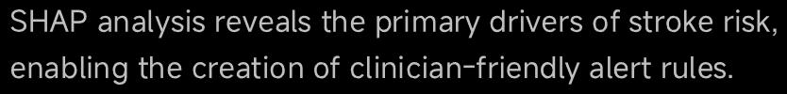
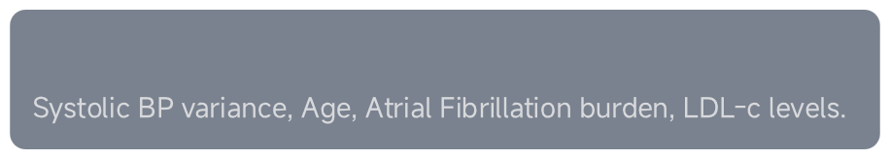
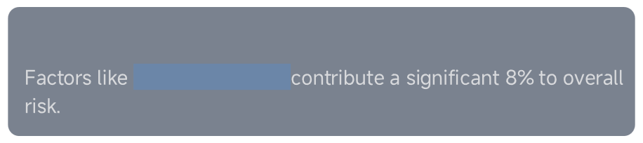
Feature Influence Decoded
Top Clinical Drivers
Lifestyle Contribution
sleep irregularity

Slide 10
03
Validation & Ethics

Slide 11

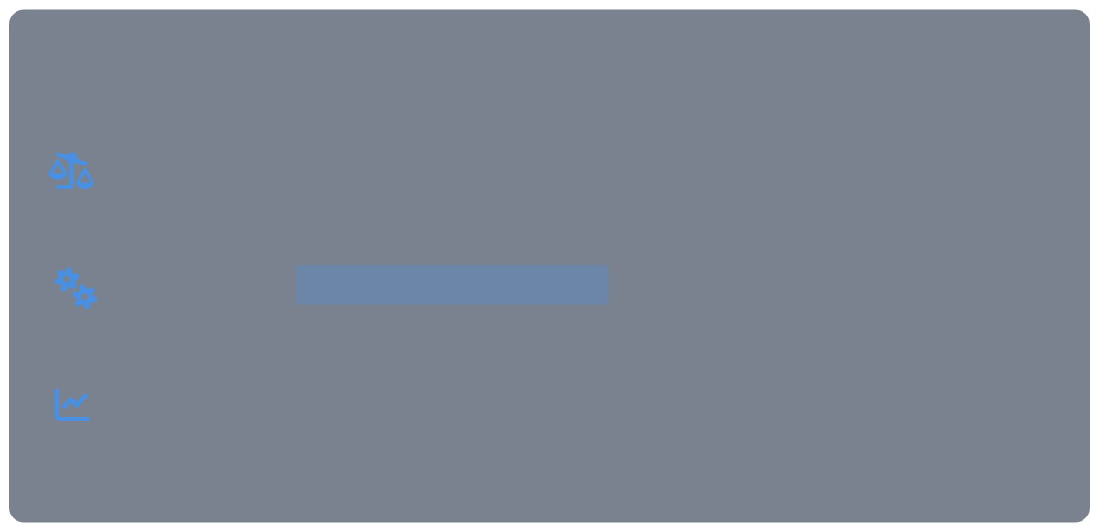
External Validation: The Reality Check
0.91
Initial Performance Drop
Key Findings & Actions
Under-prediction in African ancestry cohorts linked to genetic and
socio-economic datagaps.
0.85
Addressedvia site-specific retraining and fairness-constrained
objectives.
Model was successfully calibrated using Platt scaling for reliable probability estimates.

Slide 12


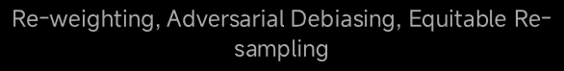
Bias Mitigation Playbook
18%
4%
Mitigation Strategies
A dedicated governance committee mandatescontinuousmonitoringtoensure the model supports health equity and
does not widen existing disparities.

Slide 13
04
Clinical Deployment

Slide 14
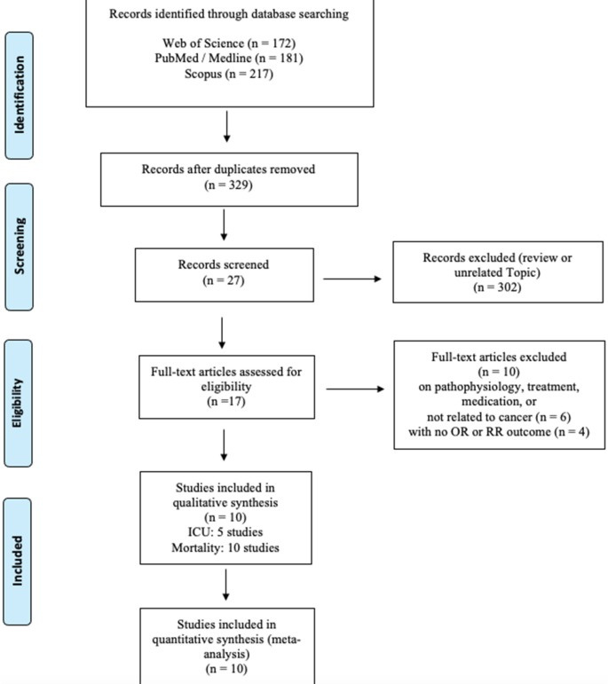
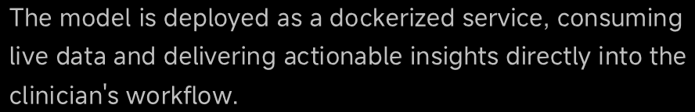
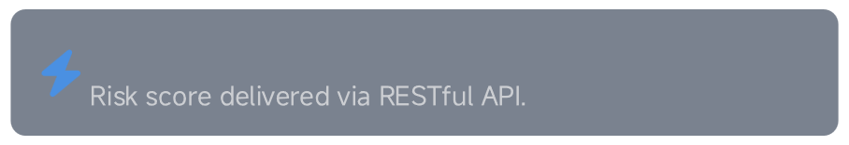
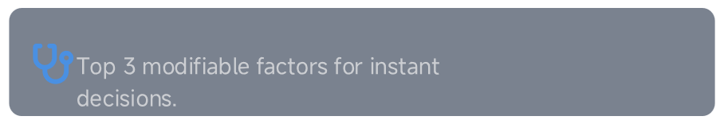
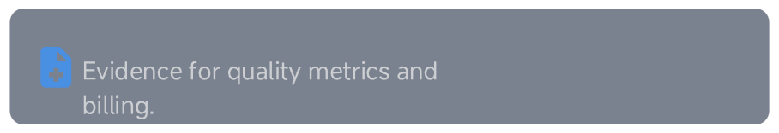
Real-Time CDS Integration
200ms Response Time
Actionable Alerts
Auto-Documentation

Slide 15
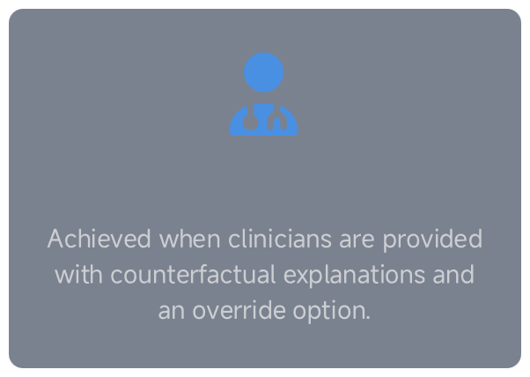
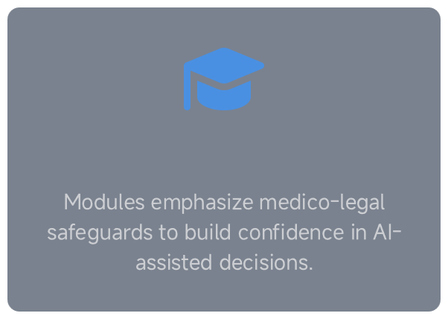
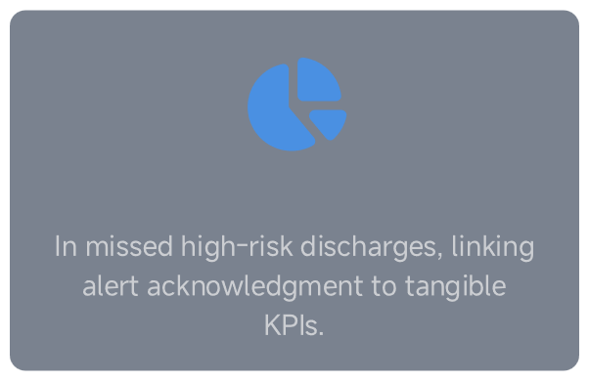
Driving Frontline Adoption
78% Trust Rate
Training & Safeguards
15% Reduction

Slide 16
05
Impact& Next Steps

Slide 17
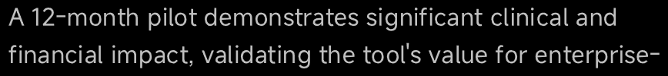

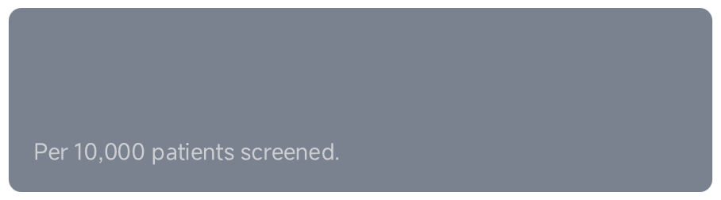

Outcome & ROI Evidence
92
StrokesPrevented
$4.1M
Cost Savings

Slide 18


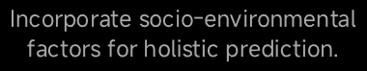
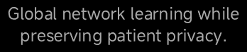
Future Model Roadmap: Towards Precision Prevention
M ul ti -O m ics
Wearable Data
Social Determinants
Federated Learning
reactive alerts to proactive, personalized prevention

Slide 19
06
Takeaways

Slide 20
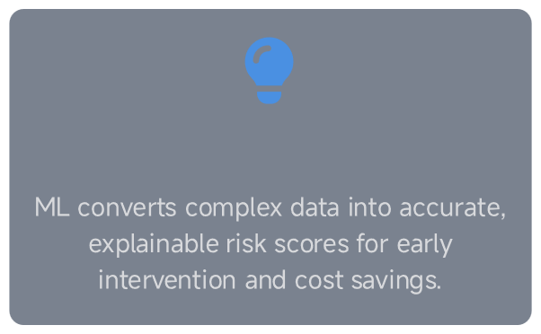
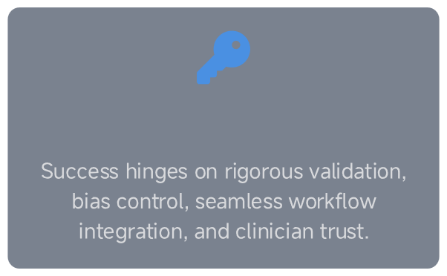
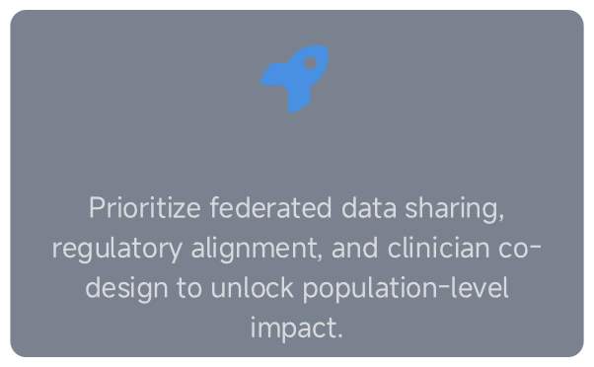
Actionable Insights Summary
The Value Proposition
The Success Factors
The Path Forward

Slide 21

THANK
YOU
DONE BY
KUNDOOR ANURAG REDDY (2403A54071)
NAYINI KALYAN REDDY (2403A54074
PUSALA SATHWIK (2403A54075)

Slide 22
11/21/25, 2:48 PM
Online Notepad
<!DOCTYPE html> <html lang="en"> <head> <meta charset="UTF-8"> <meta name="viewport" content="width=device-width, initial-scale=1.0"> <title>Predicting Stroke Risk using Machine Learning</title> <style> /* Global Styling */ body { font-family: "Poppins", Arial, sans-serif; margin: 0; background: linear-gradient(135deg, #e3f2fd, #fce4ec); color: #333; } /* Premium Gradient Header */ header { background: linear-gradient(135deg, #673AB7, #3F51B5); color: white; padding: 40px 20px; text-align: center; box-shadow: 0px 4px 15px rgba(0,0,0,0.3); } header h1 { margin: 0; font-size: 34px; font-weight: 600; letter-spacing: 1px; } header p { margin: 10px 0; font-size: 18px; opacity: 0.9; } /* Card / Glass Section Style */ section { padding: 25px; margin: 30px auto; width: 90%; max-width: 900px; background: rgba(255, 255, 255, 0.75); backdrop-filter: blur(12px); border-radius: 14px; box-shadow: 0 6px 25px rgba(0,0,0,0.15); animation: fadeIn 0.7s ease-in-out; } @keyframes fadeIn { from { opacity: 0; transform: translateY(20px); } to { opacity: 1; transform: translateY(0px); } } h2 {
https://onlinenotepad.org/notepad
1/6

Slide 23
11/21/25, 2:48 PM
Online Notepad
color: #3F51B5;
margin-bottom: 10px;
text-shadow: 0 0 1px rgba(63,81,181,0.4);
}
.model-box, .condition-box {
padding: 15px;
margin: 12px 0;
border-radius: 8px;
box-shadow: inset 0 0 7px rgba(0,0,0,0.1);
transition: transform 0.2s;
}
.model-box:hover, .condition-box:hover {
transform: scale(1.02);
}
.model-box {
background: #ede7f6;
border-left: 5px solid #673AB7;
}
.condition-box {
background: #fff8e1;
border-left: 5px solid #ffca28;
}
footer {
text-align: center;
background: #3F51B5;
color: white;
padding: 18px;
margin-top: 40px;
font-size: 14px;
letter-spacing: 1px;
}
/* Prediction Box */
.predict-box {
padding: 25px;
background: #e3f2fd;
border-left: 7px solid #2196F3;
border-radius: 12px;
box-shadow: 0 4px 15px rgba(0,0,0,0.12);
}
label {
font-weight: 600;
}
input, select {
width: 100%;
padding: 10px;
border-radius: 8px;
border: 1px solid #999;
margin-bottom: 12px;
font-size: 15px;
background: #fafafa;
https://onlinenotepad.org/notepad
2/6

Slide 24
11/21/25, 2:48 PM
Online Notepad
transition: 0.3s ease;
}
input:focus, select:focus {
border-color: #3F51B5;
box-shadow: 0 0 8px rgba(63,81,181,0.4);
}
button {
width: 100%;
padding: 14px;
background: linear-gradient(135deg, #4CAF50, #2E7D32);
color: white;
border: none;
border-radius: 8px;
cursor: pointer;
font-size: 18px;
letter-spacing: 1px;
transition: 0.25s;
}
button:hover {
background: linear-gradient(135deg, #43A047, #1B5E20);
transform: scale(1.03);
}
#result {
background: #fff3cd;
padding: 18px;
border-radius: 10px;
white-space: pre-wrap;
border-left: 7px solid #ff9800;
margin-top: 20px;
font-size: 16px;
}
</style>
</head>
<body>
<header>
<h1>Predicting Stroke Risk Using Machine Learning Models</h1>
<p>A Data Science Approach to Early Stroke Detection</p>
</header>
<section>
<h2>🔍 Introduction</h2>
<p>
Stroke is one of the world’s leading causes of death and disability. Early risk
prediction can drastically improve medical response and survival rates. This project
applies advanced Machine Learning models to evaluate stroke risk using health and
lifestyle factors.
</p>
</section>
<section>
<h2>📊 Dataset Description</h2>
<ul>
<li>Gender</li>
https://onlinenotepad.org/notepad
3/6

Slide 25
11/21/25, 2:48 PM
Online Notepad
<li>Age</li>
<li>Hypertension</li>
<li>Heart Disease</li>
<li>Marital Status</li>
<li>Work Type</li>
<li>Residence Type</li>
<li>Average Glucose Level</li>
<li>BMI</li>
<li>Smoking Status</li>
</ul>
</section>
<section>
<h2>
<ol>
<li>Data Cleaning & Preprocessing</li>
<li>Handling Missing Values</li>
<li>Encoding Categorical Data</li>
<li>Feature Scaling</li>
<li>Model Selection</li>
<li>Performance Evaluation</li>
</ol>
</section>
<section>
<h2>🤖 ML Models Used</h2>
<div class="model-box">
<h3>1. Logistic Regression</h3>
<p>Strong baseline binary classifier.</p>
</div>
<div class="model-box">
<h3>2. Random Forest Classifier</h3>
<p>Excellent for non-linear medical data.</p>
</div>
<div class="model-box">
<h3>3. Support Vector Machine (SVM)</h3>
<p>High-accuracy in complex feature spaces.</p>
</div>
<div class="model-box">
<h3>4. XGBoost</h3>
<p>Best overall performance and prediction accuracy.</p>
</div>
</section>
<section>
<h2>📈 Model Performance Summary</h2>
<ul>
<li><strong>Logistic Regression:</strong> 83%</li>
<li><strong>Random Forest:</strong> 92%</li>
<li><strong>SVM:</strong> 89%</li>
<li><strong>XGBoost:</strong> 94%</li>
</ul>
</section>
⚙ Methodology</h2>
https://onlinenotepad.org/notepad
4/6

Slide 26
11/21/25, 2:48 PM
Online Notepad
<section>
<h2>
⚠ Stroke Risk Conditions & Guidelines</h2>
<div class="condition-box">
<h3>BMI & Stroke</h3>
<p>High BMI → Increased risk.</p>
</div>
<div class="condition-box">
<h3>Blood Glucose</h3>
<p>Normal: < 140 mg/dL → Lower risk.</p>
</div>
<div class="condition-box">
<h3>Heart Disease</h3>
<p>Yes → Higher stroke chance.</p>
</div>
<div class="condition-box">
<h3>Hypertension</h3>
<p>Yes → Major stroke predictor.</p>
</div>
</section>
<section class="predict-box">
<h2>🧮 Try Stroke Risk Prediction</h2>
<label>Age</label>
<input type="number" id="age">
<label>Hypertension</label>
<select id="hyper">
<option value="0">No</option>
<option value="1">Yes</option>
</select>
<label>Heart Disease</label>
<select id="heart">
<option value="0">No</option>
<option value="1">Yes</option>
</select>
<label>Average Glucose Level</label>
<input type="number" id="glucose">
<label>BMI</label>
<input type="number" id="bmi">
<button onclick="predictStroke()">Predict</button>
<pre id="result"></pre>
</section>
<footer>
© 2025 Stroke Prediction Project | Machine Learning & Healthcare
</footer>
https://onlinenotepad.org/notepad
5/6

Slide 27
11/21/25, 2:48 PM
Online Notepad
<script>
function predictStroke() {
let bmi = parseFloat(document.getElementById("bmi").value);
let glucose = parseFloat(document.getElementById("glucose").value);
let heart = document.getElementById("heart").value;
let hyper = document.getElementById("hyper").value;
let output = "⭐ Stroke Risk Prediction Summary\n\n"; if (bmi >= 30) output += "BMI: Obese – High risk.\n";
else if (bmi >= 25) output += "BMI: Overweight – Increased risk.\n";
else output += "BMI: Normal.\n";
if (glucose > 140) output += "Glucose: High – Poor outcomes.\n";
else output += "Glucose: Normal.\n";
output += heart === "1" ? "Heart Disease: Yes – Higher risk.\n" : "Heart Disease: No.\n";
output += hyper === "1" ? "Hypertension: Yes – Strong risk factor.\n" : "Hypertension: No.\n";
document.getElementById("result").textContent = output;
}
</script>
</body>
</html>
https://onlinenotepad.org/notepad
6/6

Slide 28








11/21/25, 2:45 PM
Predicting Stroke Risk using Machine Learning
Predicting Stroke Risk Using Machine Learning Models
A Data Science Approach to Early Stroke Detection
🔍
Introduction
Strokeis oneofthe world’s leading causes of death and disability. Early risk prediction can
drastically improve medical response and survival rates. This project applies advanced Machine Learning models to evaluate stroke risk using health and lifestyle factors.
📊
Dataset Description
Gender Age Hypertension Heart Disease Marital Status Work Type Residence Type Average Glucose Level BMI Smoking Status
⚙
Methodology
1. DataCleaning& Preprocessing
2. Handling Missing Values 3. Encoding Categorical Data 4. Feature Scaling 5. Model Selection 6. Performance Evaluation
file:///K:/AI_PRO/AIPRO.html
1/4

Slide 29













11/21/25, 2:45 PM
Predicting Stroke Risk using Machine Learning
🤖
ML Models Used
1. Logistic Regression
Strong baseline binary classifier.
2. Random Forest Classifier
Excellent for non-linear medical data.
3. Support Vector Machine (SVM)
High-accuracy in complex feature spaces.
4. XGBoost
Best overall performance and prediction accuracy.
📈
Model Performance Summary
Logistic Regression:
83%
Random Forest:
92%
89%
SVM: XGBoost:
94%
⚠
Stroke Risk Conditions & Guidelines
file:///K:/AI_PRO/AIPRO.html
2/4

Slide 30








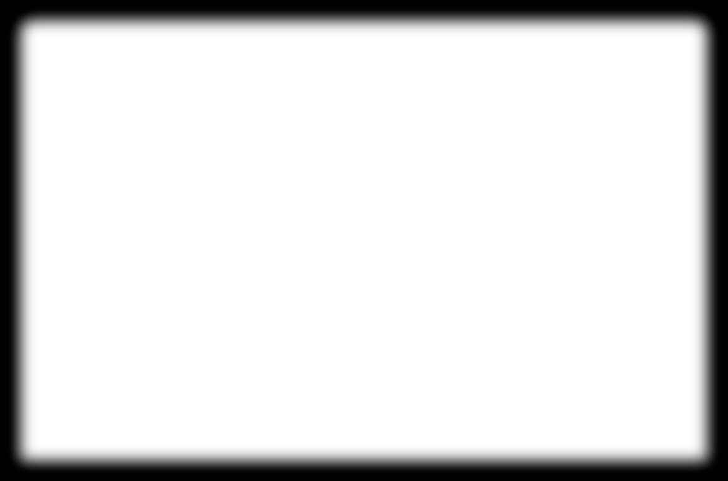
11/21/25, 2:45 PM
Predicting Stroke Risk using Machine Learning
BMI & Stroke
High BMI → Increased risk.
Blood Glucose
Normal: < 140 mg/dL → Lower risk.
Heart Disease
Yes → Higher stroke chance.
Hypertension
Yes → Major stroke predictor.
🧮
Try Stroke Risk Prediction
Age
18
Hypertension
No
Heart Disease
No
Average Glucose Level
160
BMI
file:///K:/AI_PRO/AIPRO.html
3/4

